Slide 1
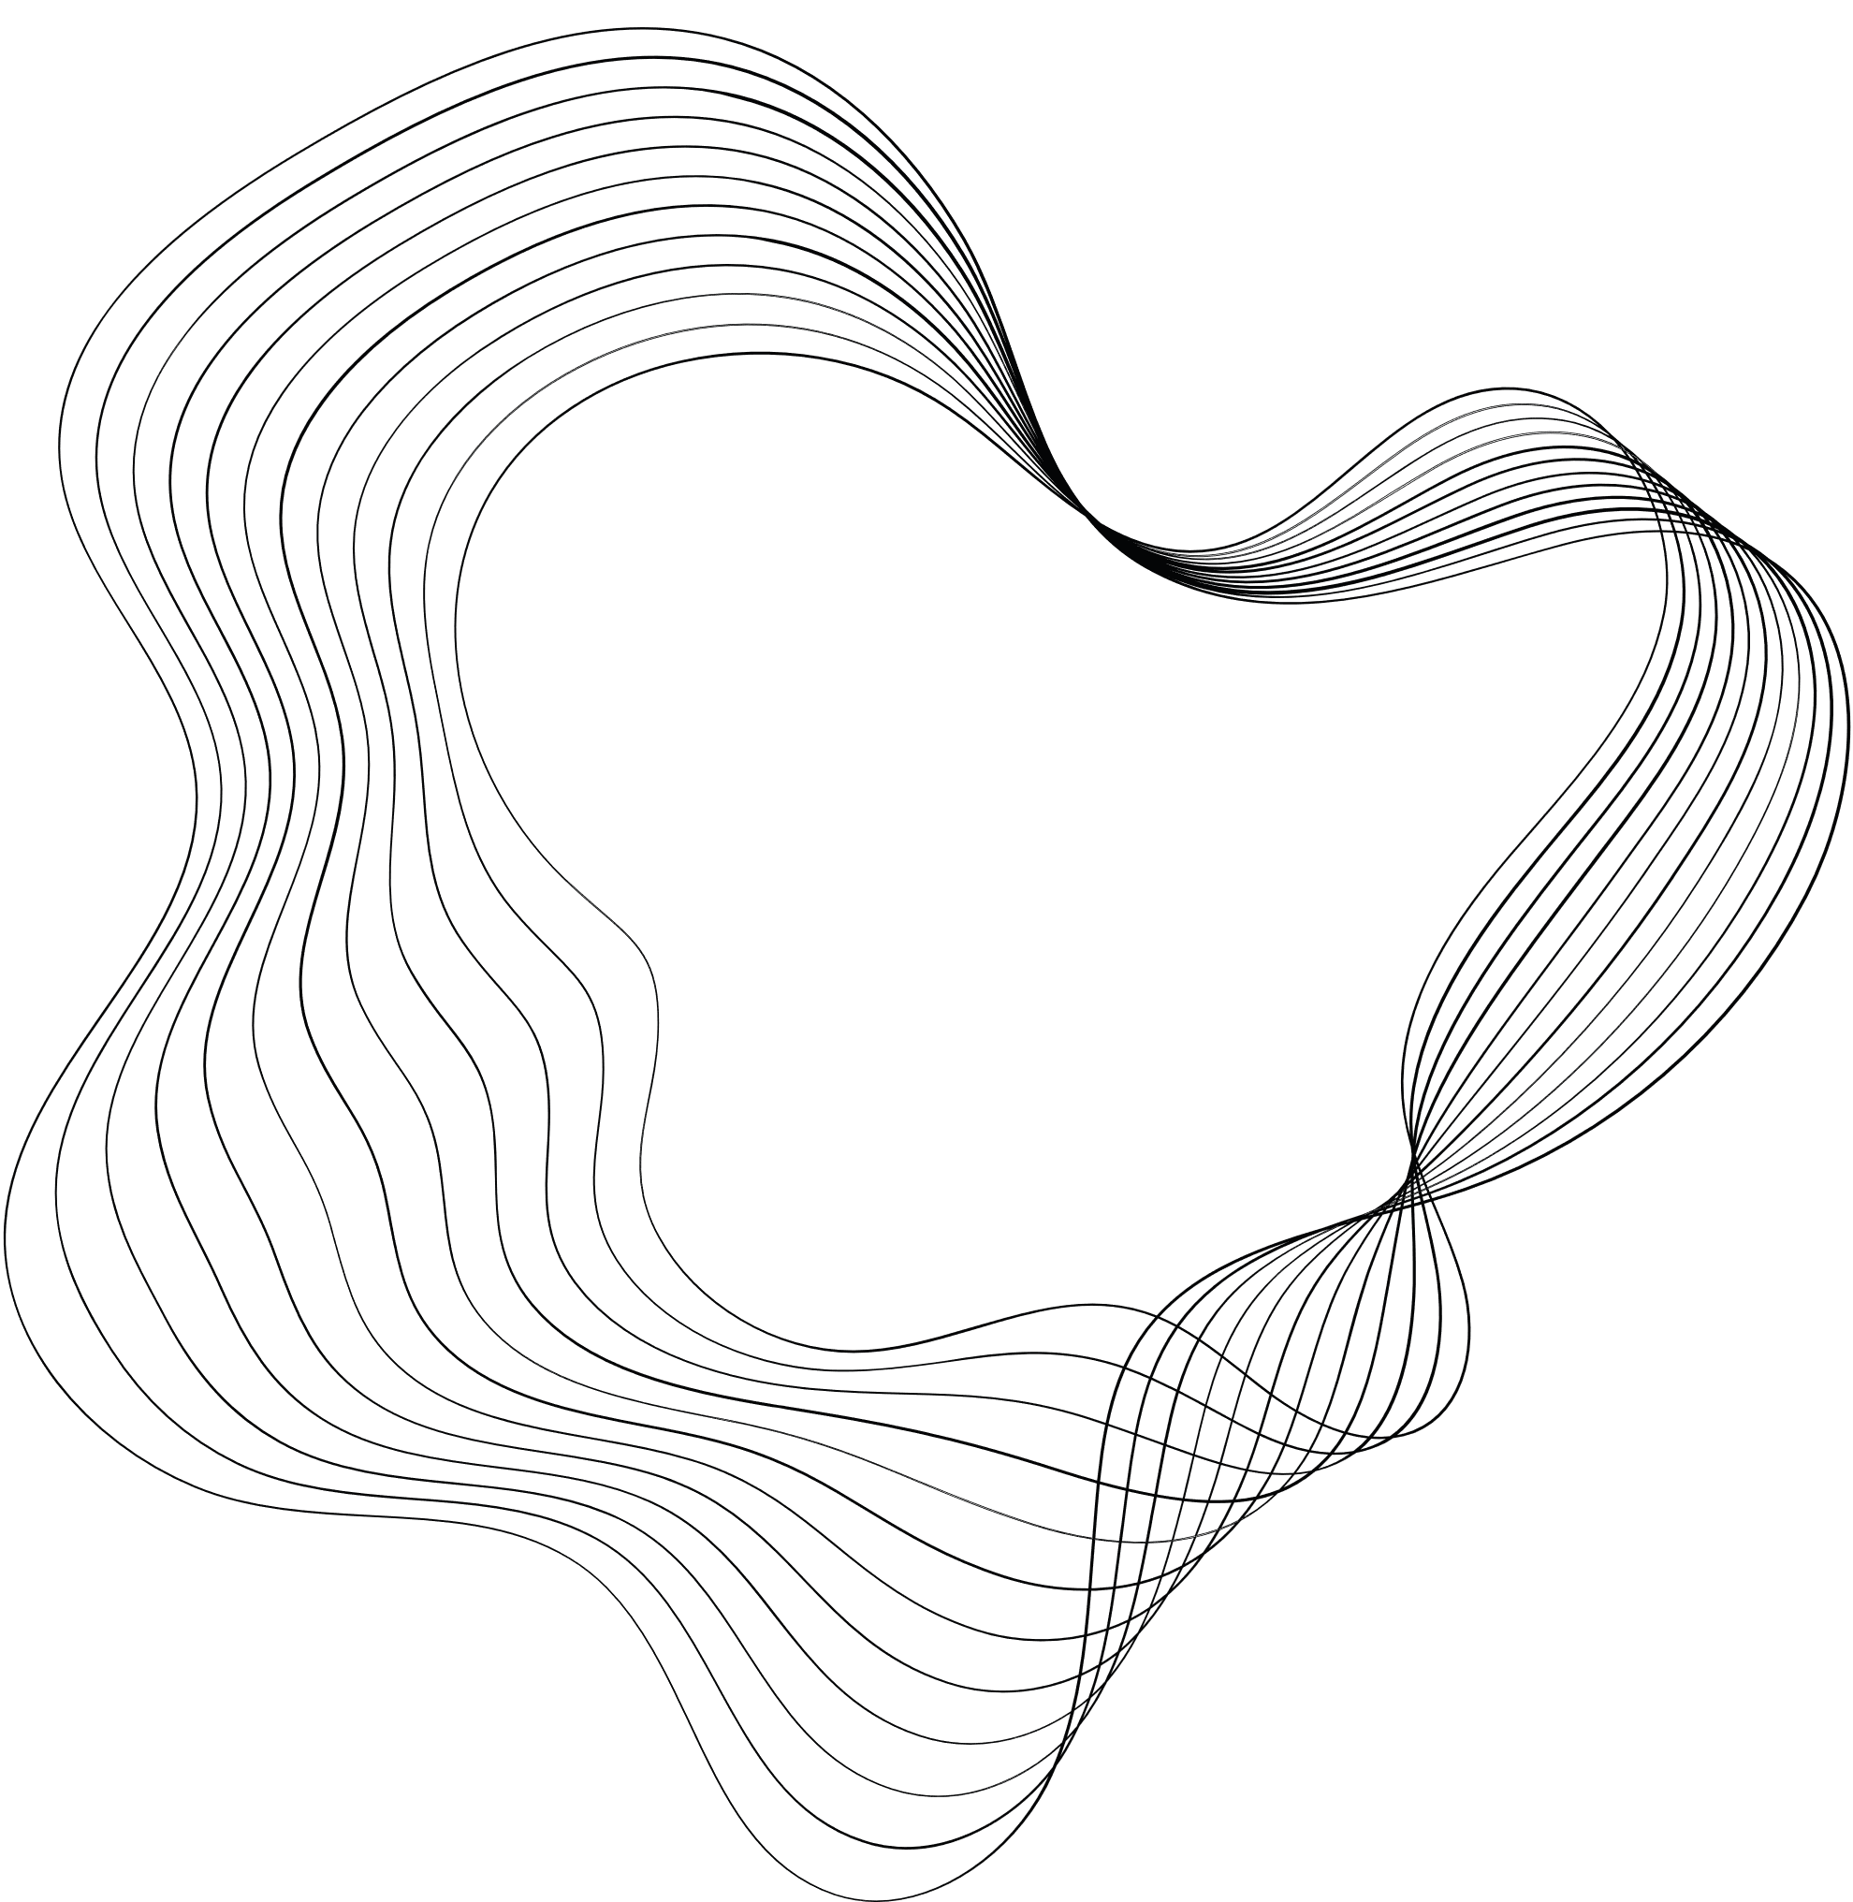

CAD DRAWING IDENTIFICATION
A COMPARATIVE STUDY

Slide 2

TEAM MEMBERS
NANDHU RAMESH
SHAMSIYA SALIM
SWATHI B S
URMILA UNNIKRISHNAN

Slide 3

CAD DRAWING IDENTIFICATION
A COMPARATIVE STUDY
This project presents a comprehensive approach to automated object recognition within Engineering CAD(Computer-Aided Design) drawings, employing both Convolutional Neural Networks (CNN) and YOLOv8 (You Only Look Once version 8). The purpose of this study is to evaluate how well each technique performs in terms of identifying and classifying diverse engineering elements within CAD drawings.

Slide 4
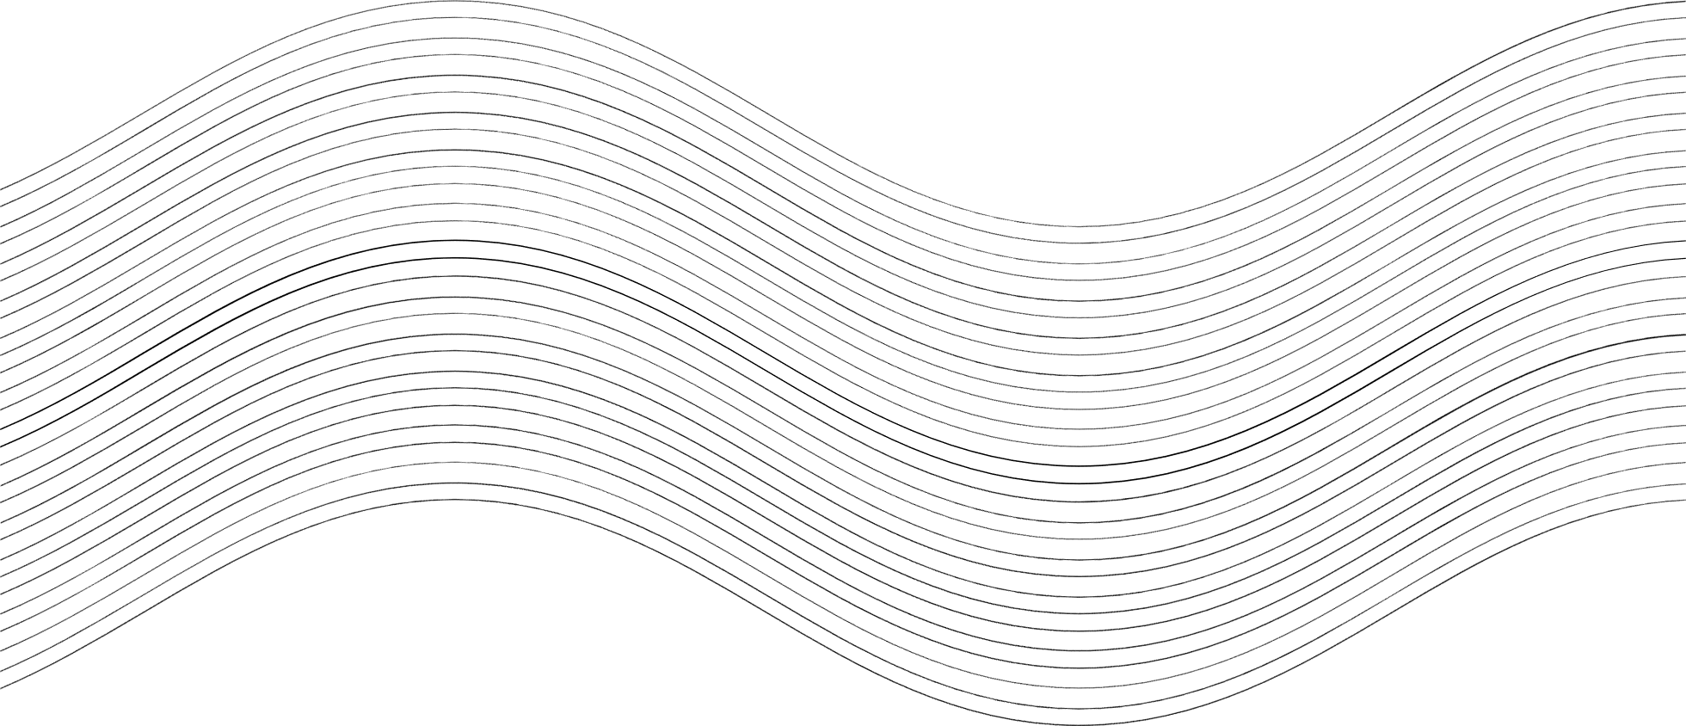

WHY CAD DRAWING IDENTIFICATION?
Addressing the Need:
- Meeting the rising demand for automated CAD drawing analysis.
- Utilizing advanced computer vision and machine learning techniques.
Objectives:
- Automate identification and classification of engineering elements in CAD drawings.
- Improve workflow efficiency and decision-making in engineering and architecture.ng productivity.
Implications:
- Streamline workflows and reduce manual effort.
- Enable more informed decision-making processes.

Slide 5
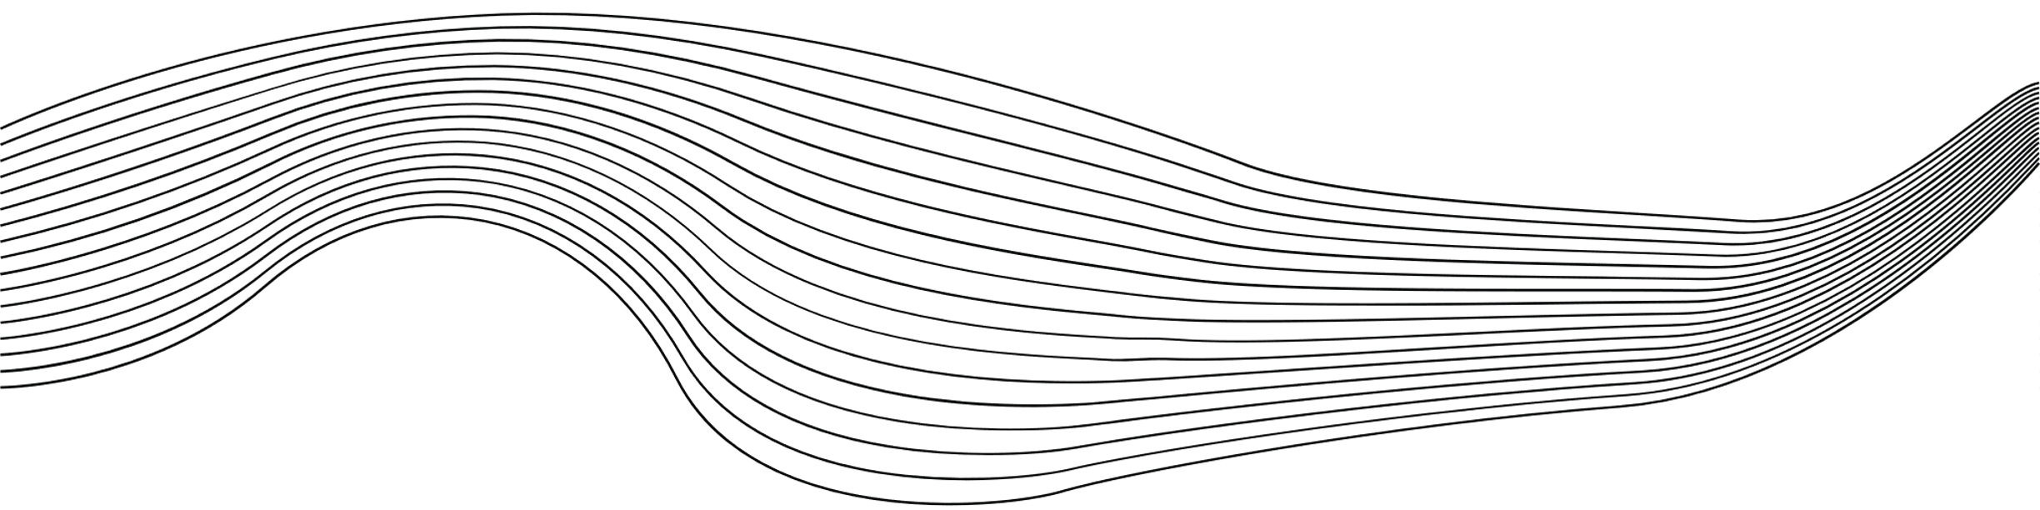
MATERIALS AND METHODS USED
01
DATASET
02
YOLO
03
CNN
04
STREAMLIT
05
HUGGING FACE

Slide 6
METHODOLOGY
Preprocessing
YOLO
Dataset from Kaggle
23 classes of pre-processed greyscale images
Resized the images to a common size
Added some more images to the test data
Data augmentation
Library used - ultralytics
Loaded the pretrained model - YOLOv8n-cls
Training on our dataset
Selected the best custom model for prediction

Slide 7
METHODOLOGY
CNN
Libraries used - Computer Vision and Pillow
Layers - Two sets of Conv2D(32, (3, 3)) and MaxPooling2D((2, 2)) with ReLu activation function, 1 Flattening Layer, 3 Fully connected Layer with Dropout Layers, and Output Layer with the activation function Softmax.
Optimizer - Adam
Loss function - Sparse Categorical Entropy
Epoch = 10, Batch size = 128, Validation set = 10%

Slide 8
RESULT AND DEPLOYMENT
Accuracy: The YOLO model achieved a slightly higher accuracy compared to the CNN model. This suggests that for our CAD drawing identification task, the YOLO model may perform marginally better in terms of overall accuracy.
- For the CNN model:
Accuracy: 0.89
- For the YOLOv8 model:
Accuracy: 0.99
YOLO has a tendency to overfit or be biased since the dataset is limited compared to the CNN model.

Slide 9
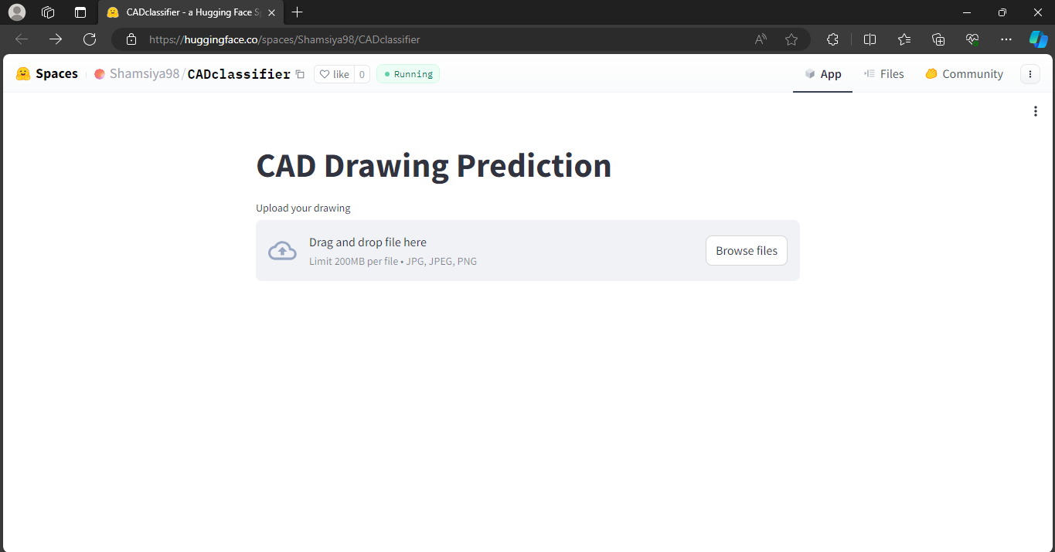
RESULT AND DEPLOYMENT
Streamlit app is deployed using the help of Hugging Face for the classification of CAD drawings using CNN and YOLO. Demo App

Slide 10
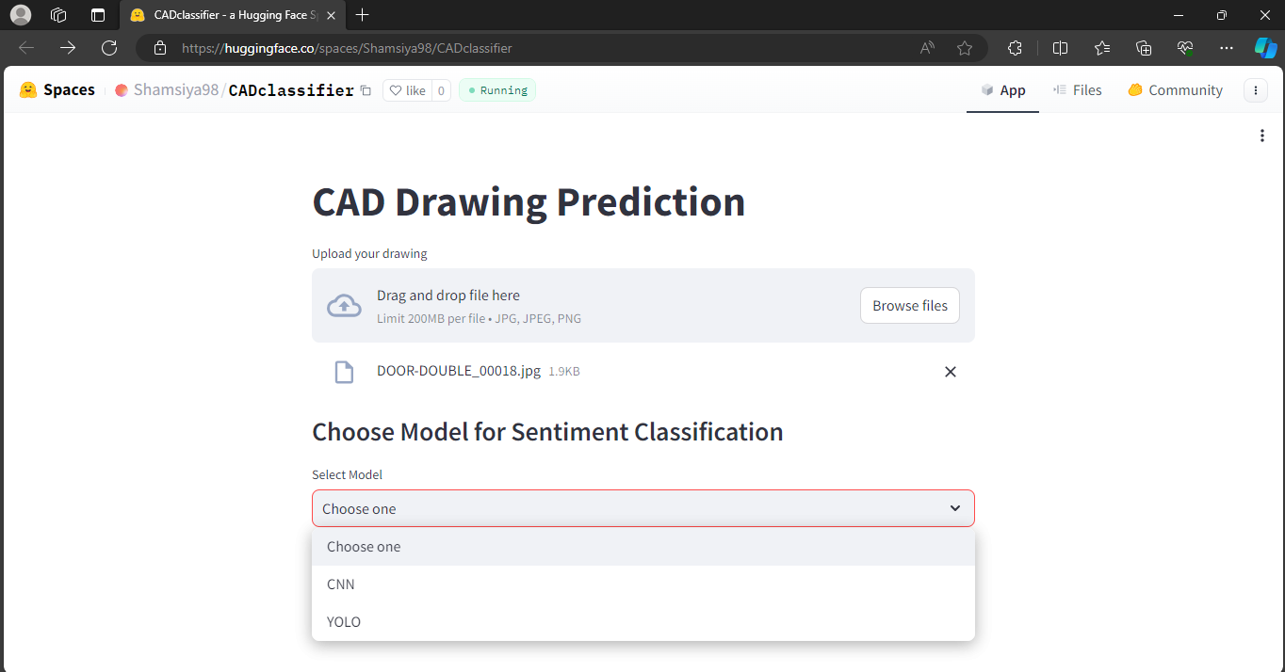

Slide 11
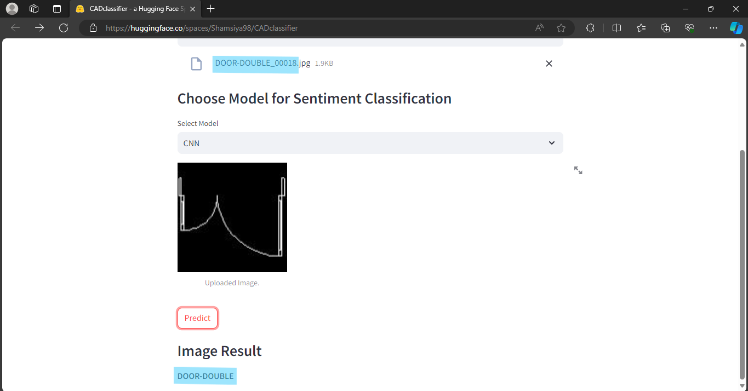

Slide 12
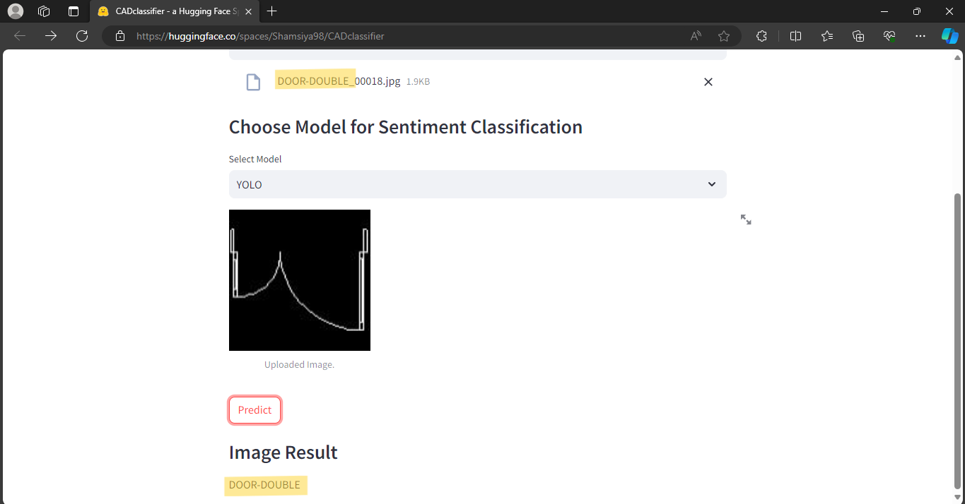

Slide 13

CONCLUSION
Comparison of CNN and YOLOv8 Models:
- Evaluated performance for CAD drawing identification.
- Both models showed promising results.
Strengths and Limitations:
- YOLOv8:
- Slightly better accuracy, precision, and recall.
- Provides direct object detection with bounding box outputs.
Further Research Directions:
- Explore techniques for enhancing performance and robustness.
- Experimentation to optimize model selection for CAD drawing identification.

Slide 14
THANK YOU!

